Slide 1
let your training journey begin

Slide 2
SAGE Research Methods
Workshop for {…}
{Your name}

Slide 3
Session outline
Introduction to SAGE Research Methods
Live platform demonstration
Final questions and session round-up

Slide 4
Session objectives
By the end of this session, participants will be able to:
Describe how SAGE Research Methods can help them in their study or research
Locate relevant resources using browse and search options
Save a resource to a list within the platform

Slide 5
Discussion Questions
What is your level of experience in using the SAGE Research Methods platform?
What would you most like to gain from attending today?
What is your biggest research methods
challenge, in terms of your own teaching
or learning?

Slide 6
Introduction to the platform
What is it? What’s in it? Who is it for?

Slide 7
SAGE Research Methods is a database containing over 5,000 resources, dedicated to the subject area of Research Methods. It supports all stages of the research process from: writing a research question, conducting a literature review, choosing the best research methods, analysing data, to writing up your results and thinking about publication.
You can access the platform at:
http://methods.sagepub.com/

Slide 8
What’s in it?
The content you can access through SAGE Research Methods will depend on the subscription at your library
It’s possible your library does not subscribe to all of our content
If you do not have access to particular content, you will see the following icon next to the resource:
If you aren’t sure which content your institution subscribes to, please check with your library staff

Slide 9
2011
SAGE Research Methods launched.
2014
SAGE Research Methods Cases 1 added.
2015
SAGE Research Methods Datasets 1 added.
2016
SAGE Research Methods Video added.
2017
Project Planner tool added.
SAGE Research Methods Video: Practical Research and Academic Skills added.
2018
SAGE Research Methods Video: Data Science, Big Data Analytics, and Digital Methods, Cases 2 and Datasets 2 added.
2019

Slide 10
Content
Content is written by researchers, who largely are research methods faculty from a broad range of disciplines.
Content is peer-reviewed by experts in that field.
Content is commissioned by:
Utilising pre-existing relationships with authors who have written key research methods text books or journal articles.
Calls for papers.
Contacting individuals doing interesting research.
Meeting researchers at conferences.

Slide 11
Who is it for?
Students learning about and doing research for the first time
Consolidate topics covered in lectures and seminars
Explore options beyond core modules
Practise key skills and see concepts applied in real-life
Seasoned researchers conducting their own projects
Justify methodology with high-quality reference works
Develop their skillset in their own way
Explore new methods not used before
Better understand publishing and dissemination practices
Faculty teaching Research Methods and supervising projects
Engage students with high-quality, reliable resources
Access ready-made items designed with pedagogy in mind (videos, cases, datasets)
Share resources free at the point of access, with no access restrictions
Librarians providing research subject, information workshops
One central resource for a huge range of research resources
Use effective resources in training and outreach
Engage faculty with resources that demystify the research process

Slide 12
Getting started on the platform
The homepage, browsing, searching

Slide 13
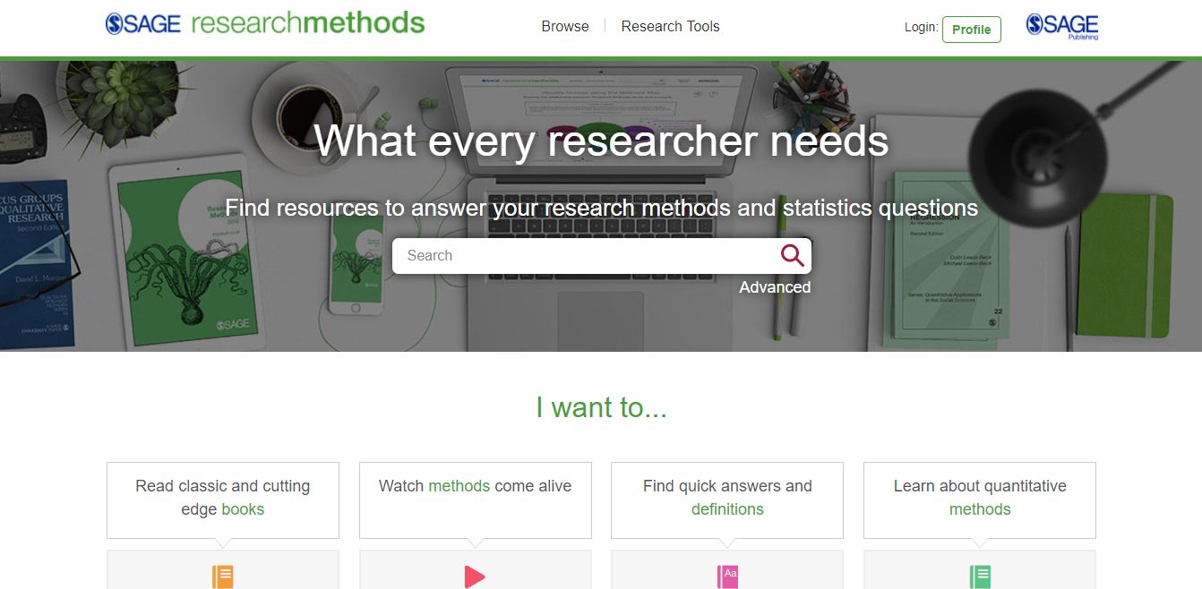
The SAGE Research Methods homepage methods.sagepub.com
SAGE Research Methods content will also be available through your library catalogue, and search engines like Google.
Please note, it is possible that some of these content options will appear in grey on your screen, if your institution does not subscribe to a particular content group.

Slide 14
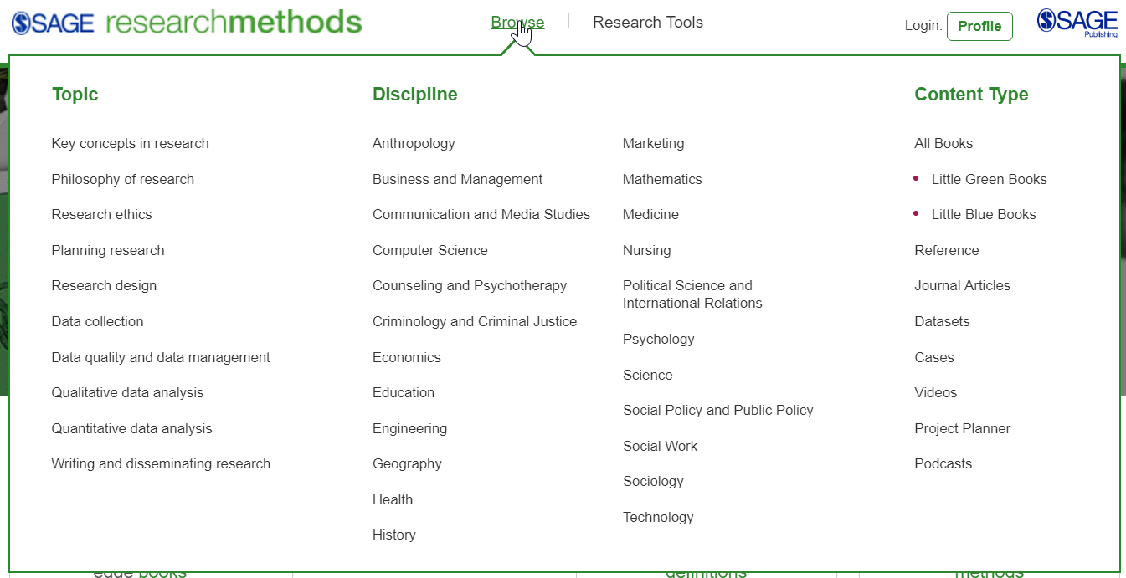
Using Browse options
Click on any of the links to get to a list of results.
Use the Browse drop-down menu to browse by Topic, Discipline, or Content Type.
Please note, it is possible that some of the content types will have a padlock icon next to it or not appear, if your institution does not subscribe to a particular content group.

Slide 15
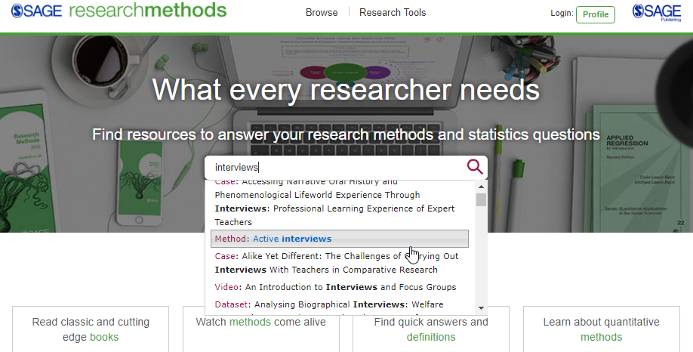
Using the Quick search
Use the quick search to look for key words and phrases; you can use Boolean Operators AND, OR and NOT.

Slide 16
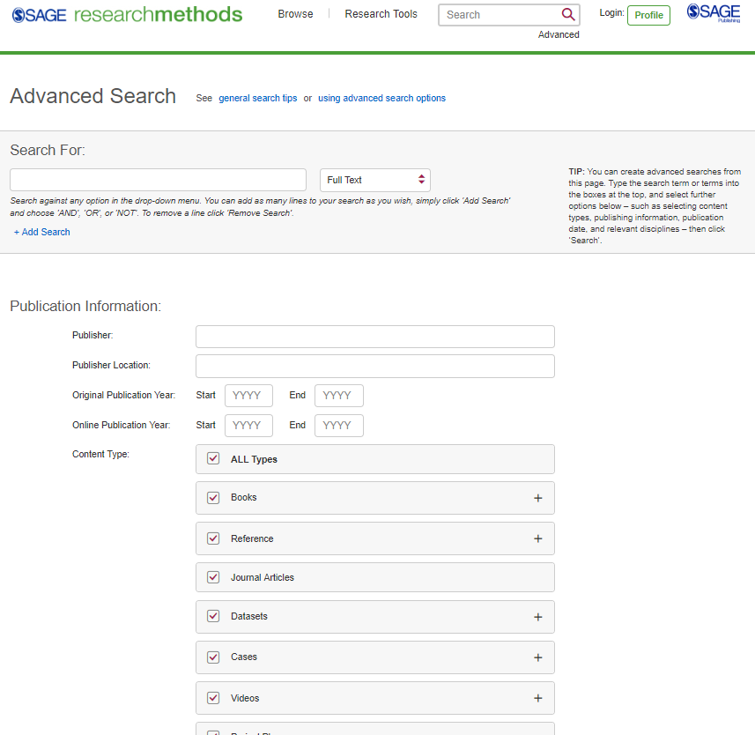
Using the Advanced search
Enter your search criteria, and add new rows to search multiple criteria
Access the Advanced search from any page on the platform
Search specifically for publishers, e.g. authors
Select which content types you want to search across
Select your publication date ranges
Explore more search options further down the page

Slide 17
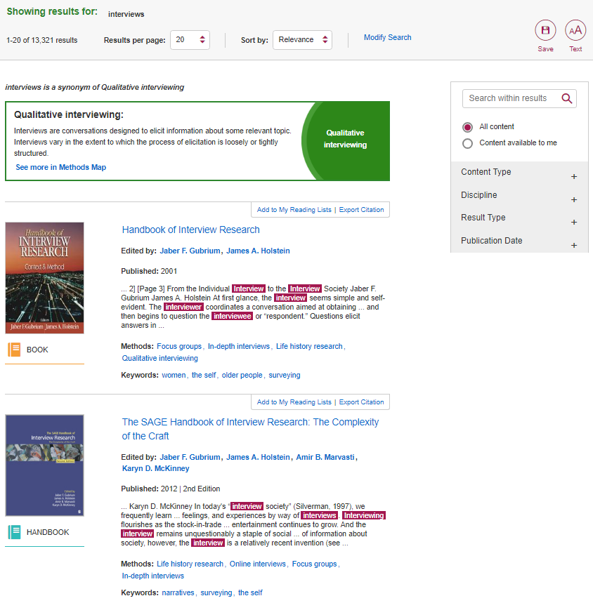
Viewing your results
The Refine By filter ensures that you only see resources that are available through your library’s subscription.
Click the resource title to view the full text.
Resource is not available through your library’s subscription
Use the filters on the right-hand side of the search results page to refine your search by Content Type, Discipline and Publication Date.

Slide 18
Creating a Profile
Saving searches, and adding resources to reading lists

Slide 19
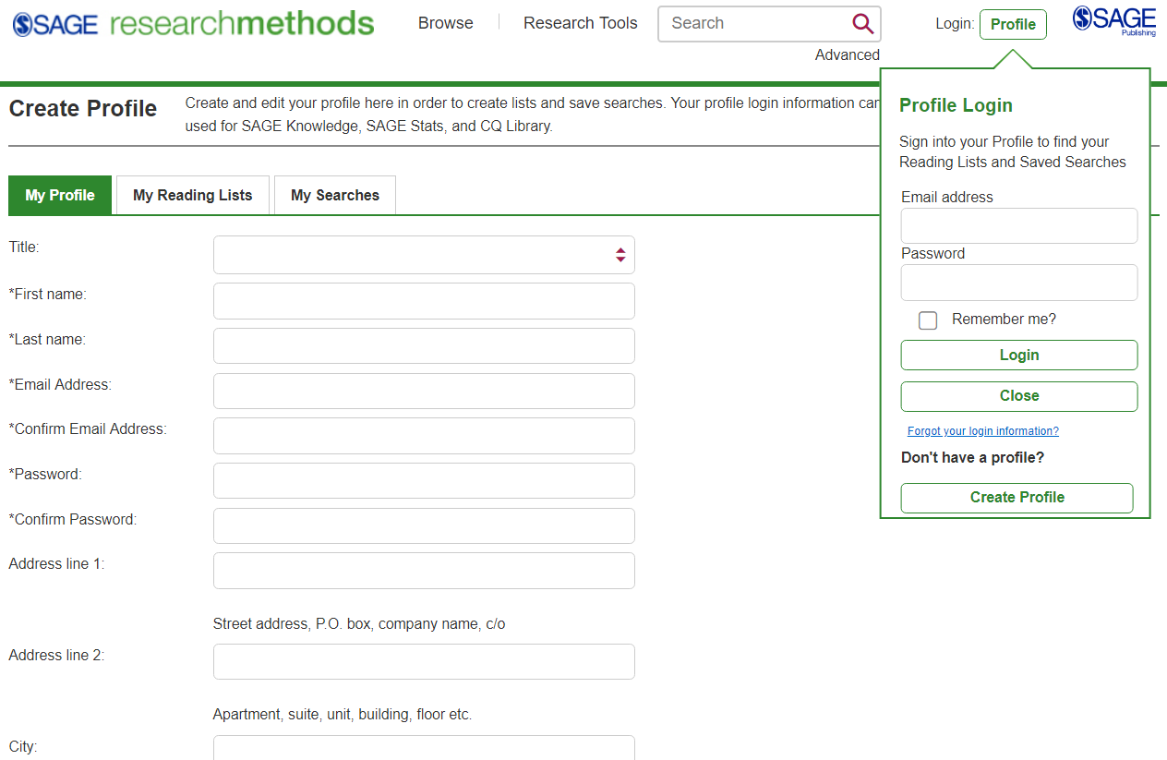
Creating a profile
Click the Profile button and then click on the button Create Profile.
Click the Profile button and then click on the button Create Profile.
Once you’ve created your free Profile, you can log in here at any time.
Once you’ve clicked the button, fill in your details in the registration form to set up your free Profile, so that you can save searches, and add resources to reading lists.

Slide 20
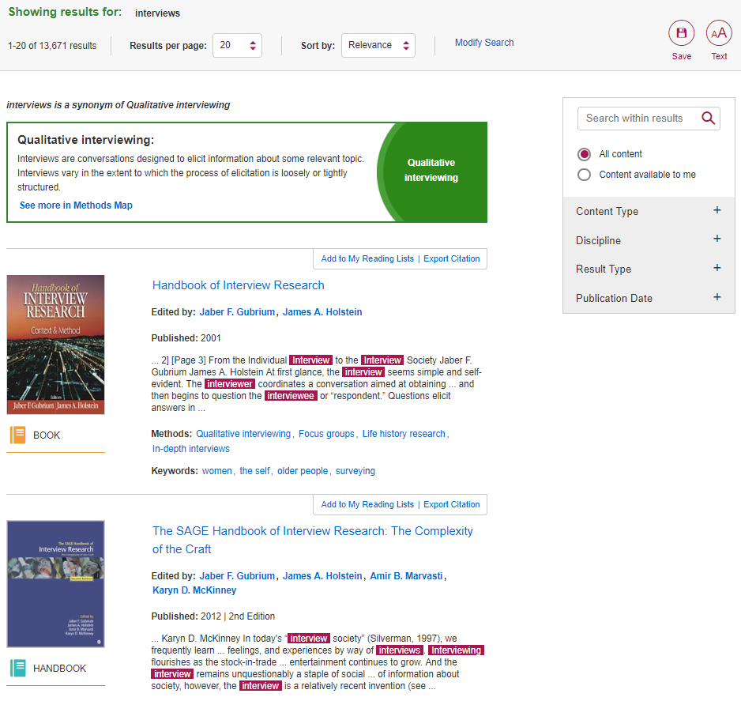
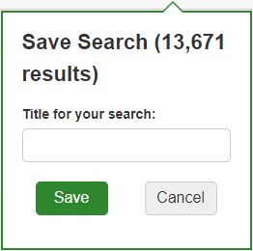
Saving searches
When you’re logged into your Profile and you are viewing your search results, click the red Save button to save your search criteria, so that you can quickly re-run the same search again later.
Once you’ve clicked the red Save button, give your search a title, and then click the green Save button.

Slide 21
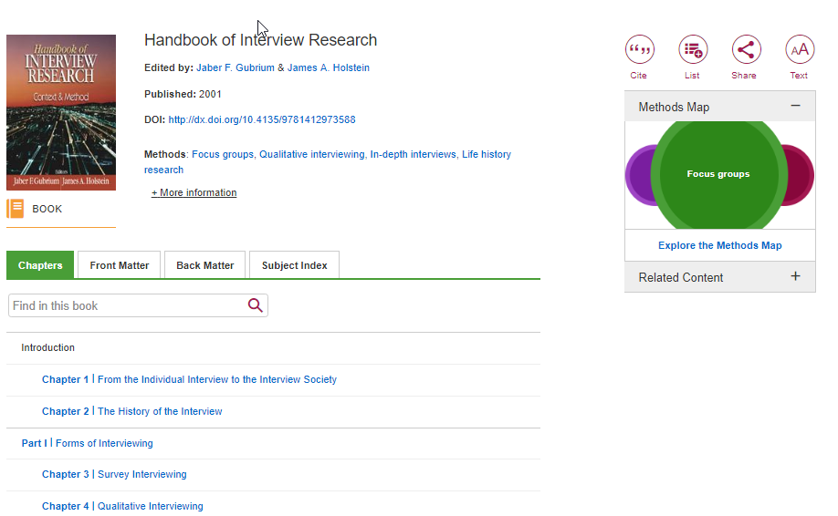
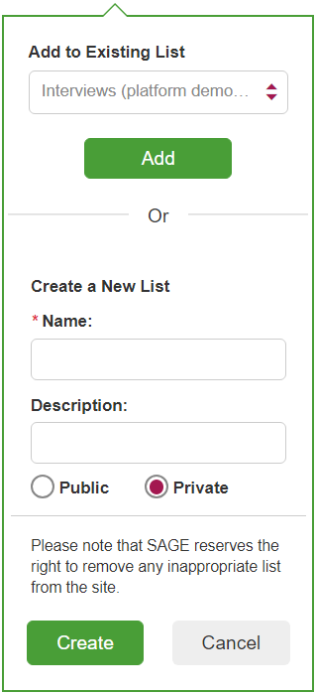
Managing reading lists
When logged in to your Profile, you can add resources to My Reading Lists in order to save items of interest for later.
On any resource page, click the List icon.
When the pop-up window appears, choose an existing list to add your case to, or create a new list.

Slide 22
Reading Lists
Reading Lists are set to public by default to encourage sharing among users, but you can make your list private to keep it for your own use, and share with others you choose.
Faculty members can use the Embed feature to share a Reading List with their students on their learning management system (LMS) or virtual learning environment (VLE).

Slide 23
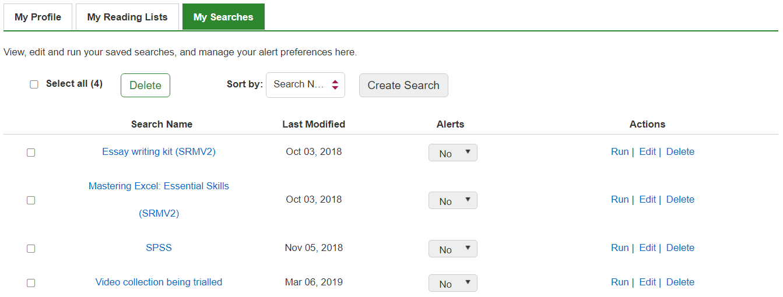
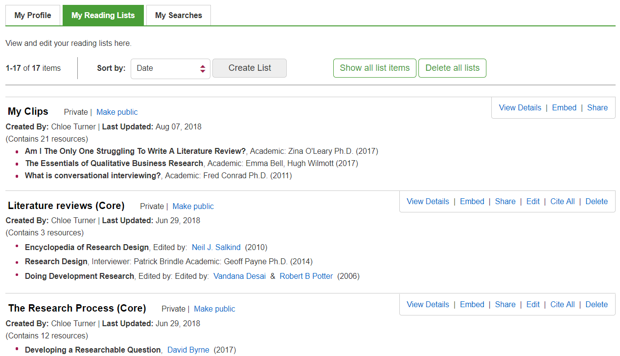
Managing your Profile
You can access your reading lists and saved searches by clicking on My Profile from any page when you are logged in.
My Reading Lists
My Searches

Slide 24
Content types
SAGE Research Methods Core
SAGE Research Methods Cases 1+2
SAGE Research Methods Datasets 1+2
SAGE Research Methods Video, SAGE Research Methods Video Practical Research & Academic Skills, SAGE Research Methods Video: Data Science, Big Data Analytics, and Digital Methods

Slide 25
SAGE Research Methods Core
Books, Reference, Journal articles and 75 videos.
Books – comes in 5 categories:
Books – full digital versions of print text
Handbooks – comprehensive coverage of specific subjects
Little Blue Books – in-depth guide on specific qualitative research methods
Little Green Books – in-depth guide on specific quantitative research methods
Major Works – volumes of curated book and journal content that address particular methods of research
Reference – comes in 2 categories:
Dictionary – quick definitions of research methods concepts.
Encyclopaedia – longer definitions with more context.

Slide 26
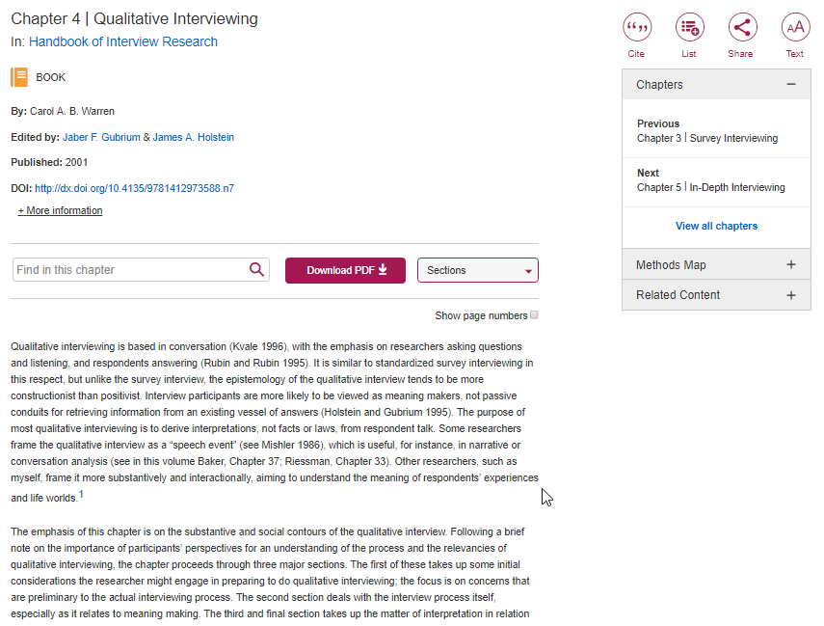
Resource page
Use the icons to the right of the resource title to: Cite the resource, add the resource to a List, or Share with a friend, student or colleague.
Search for a term within this resource
View titles on SAGE Research Methods similar to the resource you are viewing
Download this resource as a PDF
Full text of resource continues down the page

Slide 27
SAGE Research Methods Cases are detailed records of how real research projects are conducted, written by the researchers themselves.
They explain why the researchers chose the research methods, how they overcame challenges, what went well, and what they might have done differently.

Slide 28
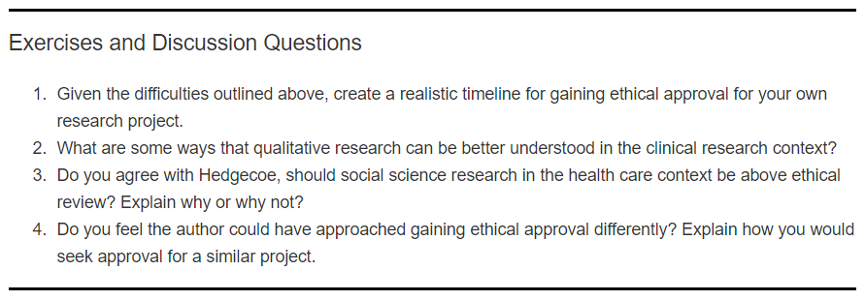
SAGE Research Methods Cases
Use the icons to the right of the resource title to: Cite the resource, add the resource to a List, or Share with a friend, student or colleague.
Search for a term within this case
View titles on SAGE Research Methods similar to the case you are viewing
Full text of case continues down the page
Download this case as a PDF
All Cases come with Exercise and Discussion Questions, and Learning Outcomes, which make them great for self-study and as a ready-to-go teaching resource.

Slide 29
SAGE Research Methods Datasets is a collection of sample datasets and instructional guides that can be used to support the teaching and independent learning of quantitative and qualitative data analysis techniques.

Slide 30
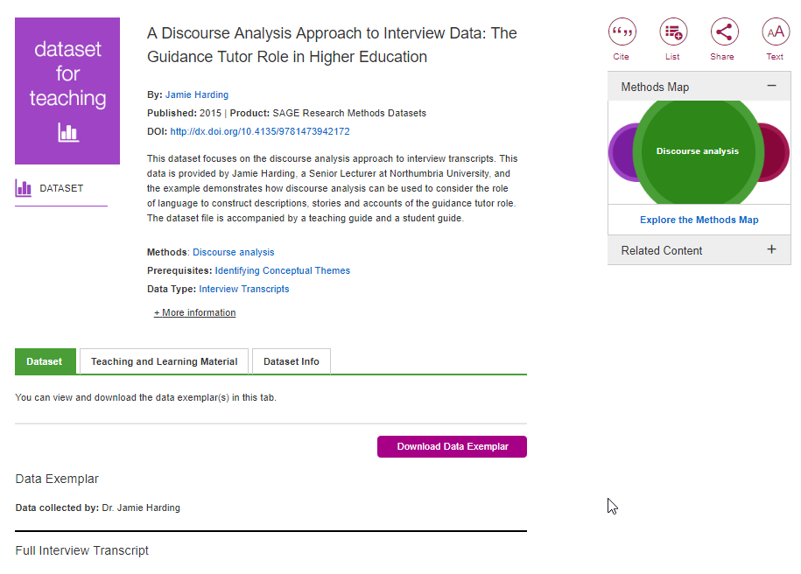
SAGE Research Methods Datasets
Use the icons to the right of the resource title to: Cite the resource, add the resource to a List, or Share with a friend, student or colleague.
Click on the Teaching and Learning Material tab to access the Teaching Guide for tips on how to use the dataset, and the Student Guide for a step-by-step guide to doing the data analysis technique.
View titles on SAGE Research Methods similar to the dataset you are viewing
Download this dataset as a PDF
Datasets are used for:
Classroom and lab assignments to support learning.
Independent learning or practice of analytical methods.
Refresher training of data analysis techniques.
Full text of the dataset continues down the page

Slide 31
SAGE Research Methods Video is a streaming video collection created to support undergraduate teaching, student reference, research projects and higher level academic interest material.
Content covers the entire research methods and statistics curriculum.

Slide 32
SAGE Research Methods Video: Practical Research and Academic Skills is a streaming video collection which offers support on the practical skills needed to successfully complete research. Practical skills such as project management, writing for publication, presenting work, and building networks are covered.

Slide 33
SAGE Research Methods Video: Data Science, Big Data Analytics, and Digital Methods is a streaming video collection covering a range of data science methods, the issues and challenges of using big data and digital methods, and the intersection of computer science and the social sciences.

Slide 34
SAGE Research Methods Video
VIDEO – comes in 8 categories.
Definition – 1-2 minute description of a key concept by a leading academic.
Documentary – licensed films from various content partners.
In Practice – practitioner contexts and methods applied to real world situations, help to make connections between theory and practice.
Interview – leading academic in the field going into depth about their experiences and observations on research methods.
Lecture – filmed at events such as conferences, academics giving a lecture.
Tutorial – overview of a key course topic; how to understand it, how to do it, what the key points are.
Video Case - explain how a researcher did their research, which methods they chose and why and how they overcame any practical or methodological challenges.
Conversations – between academics about a concept or topic, offering interesting insights and perspectives.

Slide 35
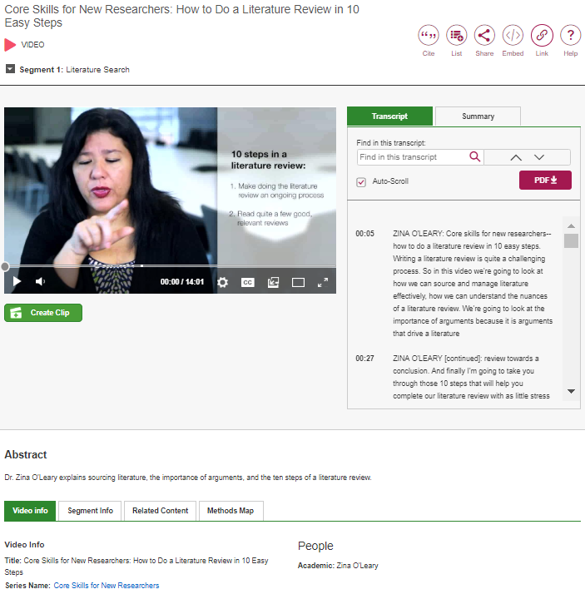
SAGE Research Methods Video
Search within the video transcript for your key words
Click on the video segment to navigate to different sections of the video
Use the functions at the bottom of the video display to adjust the volume, increase and decrease the video quality and playback speed, add subtitles, open in a new tab, or view full-screen.
Download the video transcript as a PDF
Use the auto-scrolling transcript to follow along with the video as it plays
Use the tabs underneath the video to access more information, and discover titles on SAGE Research Methods similar to the video you are viewing

Slide 36
SAGE Research Methods Video
Use the icons to the right of the video title to: Cite the video, add the video to a List, Share with a friend, student or colleague, Embed into a learning management system (LMS) or virtual learning environment (VLE), or Link to generate a permalink to link to the video page directly.
Videos can be:
Set as pre-class viewing to stimulate in-class discussion.
Shown in class to provide an alternative viewpoint.
Embedded into a learning management system (LMS) or virtual learning environment (VLE) for revision purposes.

Slide 37
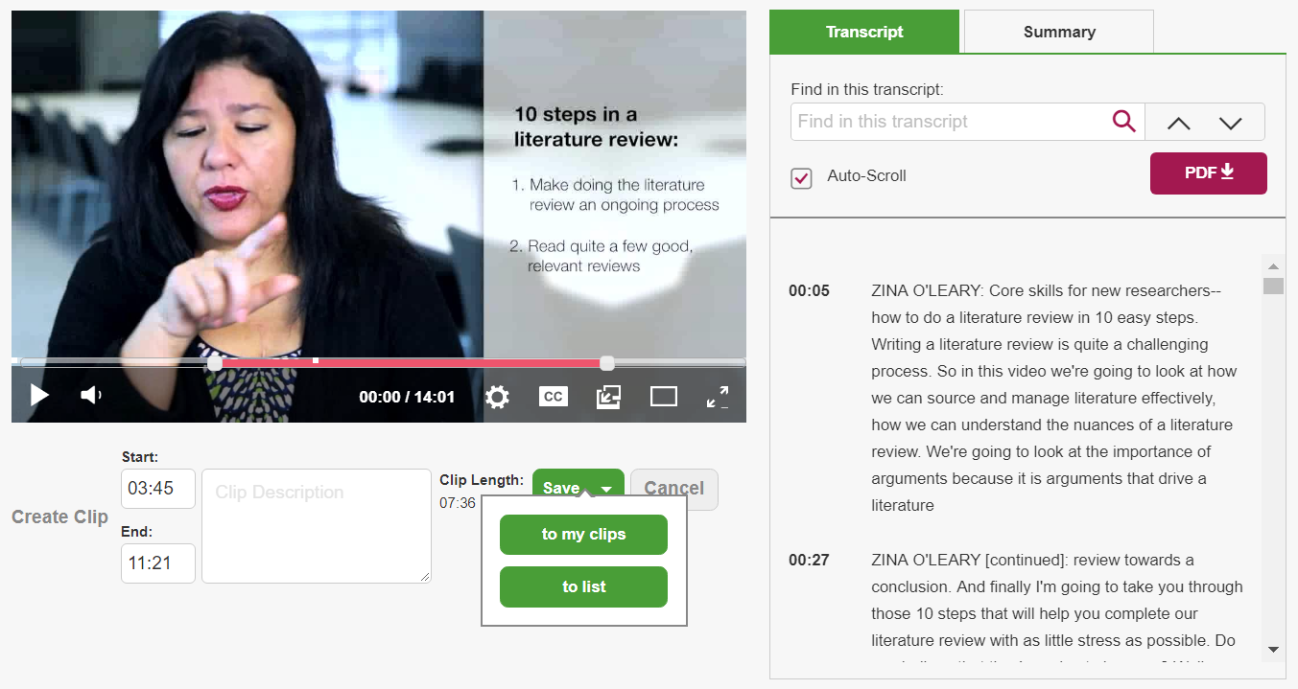
Create video clips
Create video clips
Click on Create Clip.
Use the sliders that appear on the video to select the start and end times of your clip.
Click on Save to add to the clip To My Clips (a list just for clips) or To List.
Choose the list you’d like to add the video clip to, or create a brand-new list.
*You will need to be signed in to your Profile to save clips.*
TIP: To learn how to access your reading lists, click here.

Slide 38
Research Tools
Methods Map and Project Planner

Slide 39
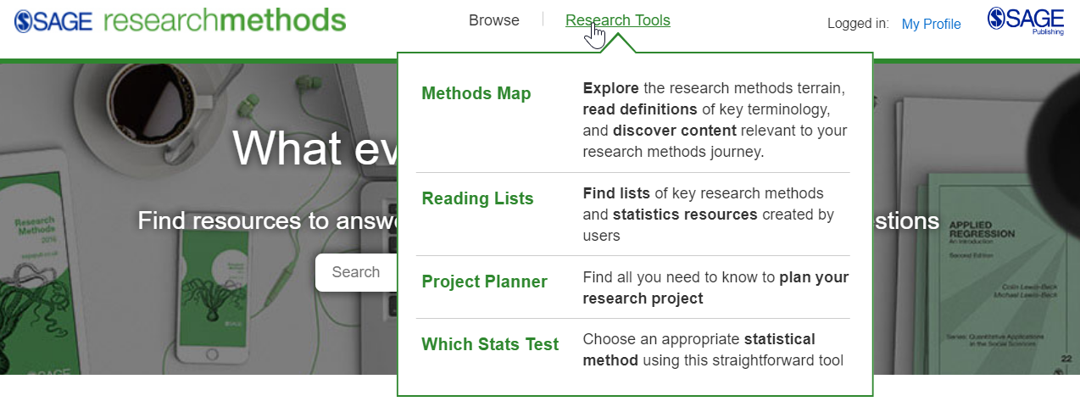
Accessing the Research Tools
Access the Research Tools from anywhere in the platform at the top of the page, under Research Tools.

Slide 40
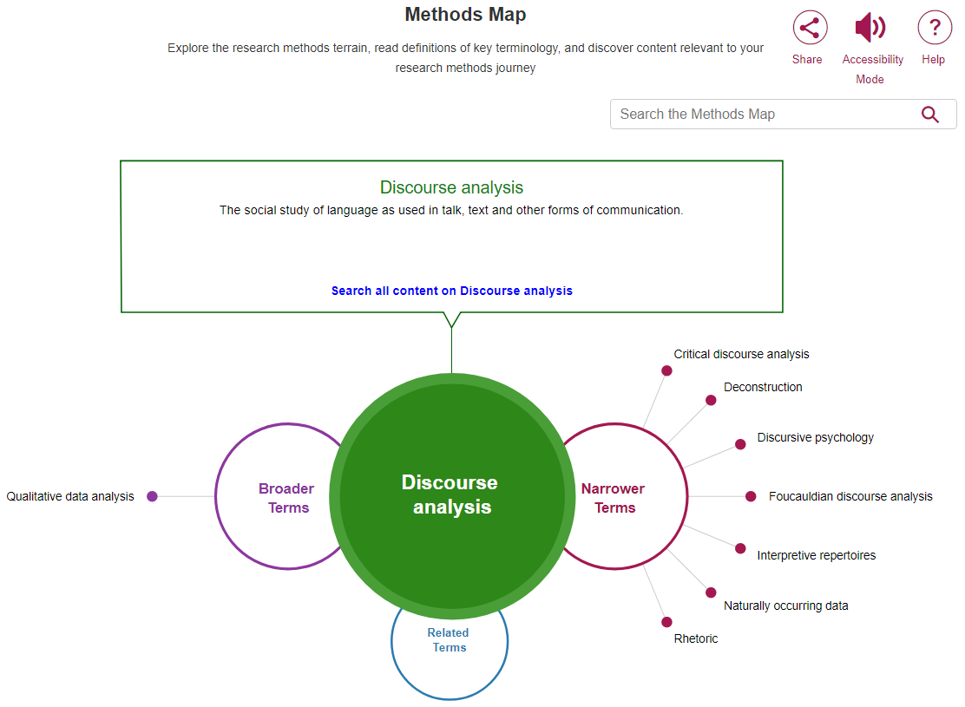
Methods Map
Methods Map is a visualisation tool to help understand the relationship between different research methods concepts.
A definition of the term appears at the top centre of the screen
Search the Methods Map to find a research methods concept
Click Search all content to be taken to search results related to the central concept in the green circle
Broader Terms appear to the left, and Narrower Terms appear to the right, so you can easily explore related concepts and content

Slide 41
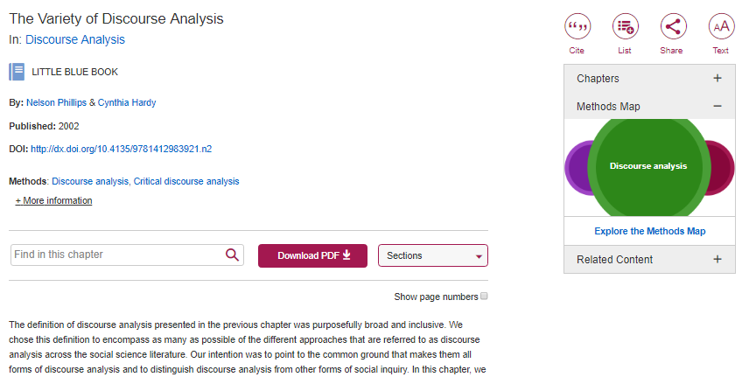
Methods Map
Methods Map can also be accessed from the resource page on the right-hand side, making navigation seamless between content and tools.

Slide 42
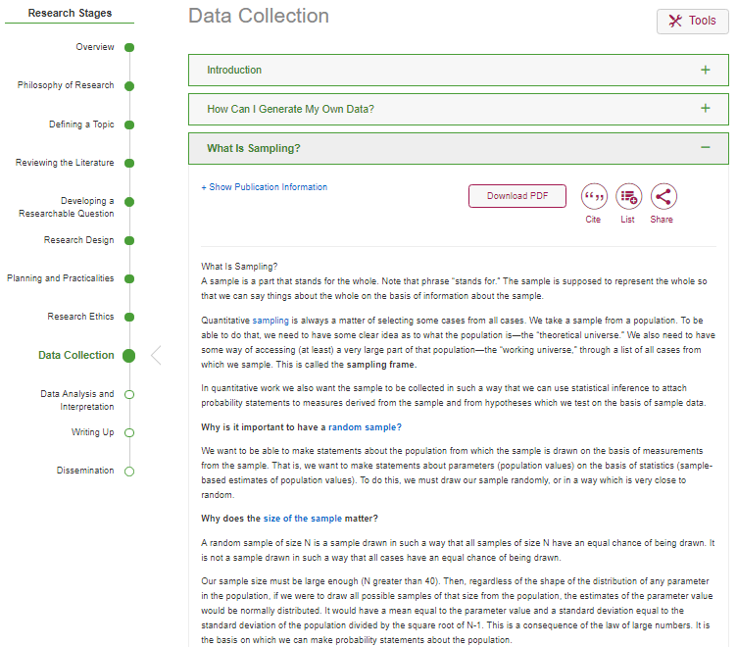
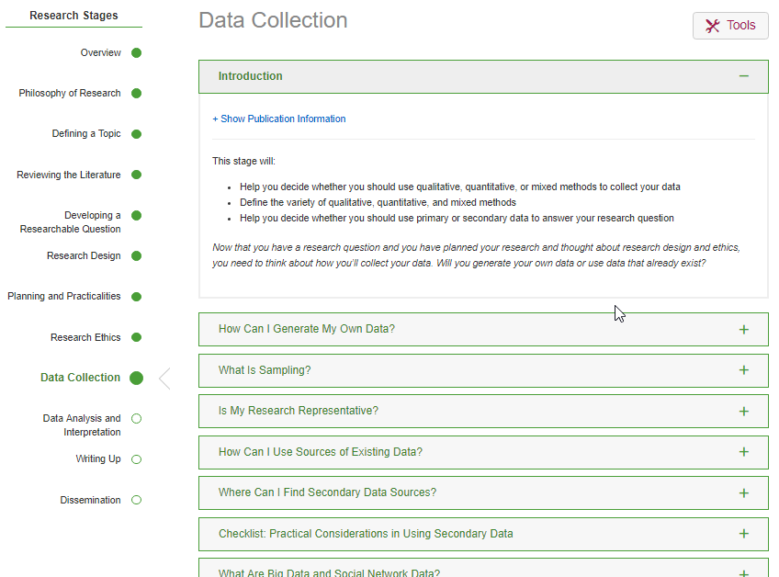
Project Planner
Project Planner walks through the research process from start to finish in logical steps.
This enables you to dip in and out, or work through step-by-step, with each section broken down into manageable questions.

Slide 43
Do you have any questions?

Slide 44
Thank you for listening!

