Slide 1
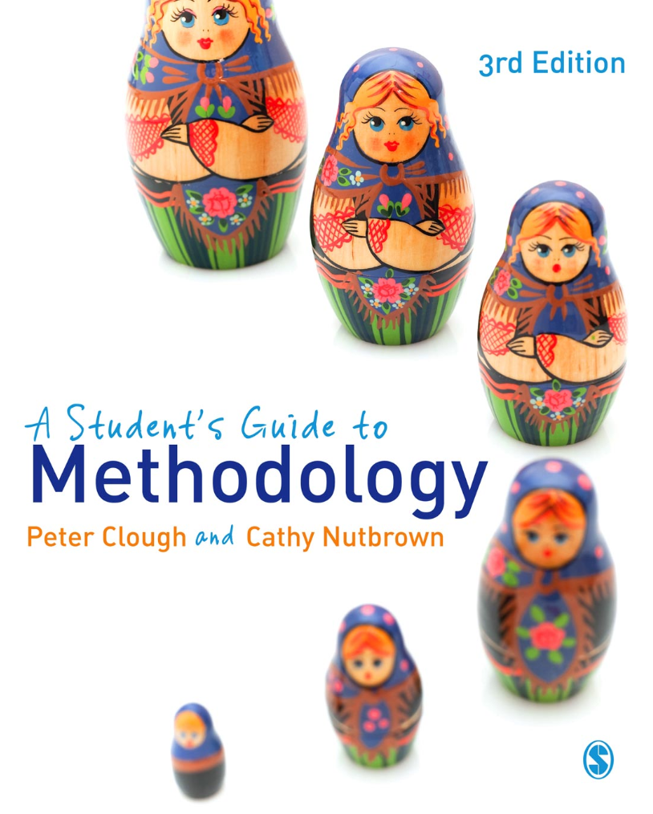
A Student’s Guide to Methodology
Justifying Enquiry
3rd edition
Peter Clough and
Cathy Nutbrown

Slide 2
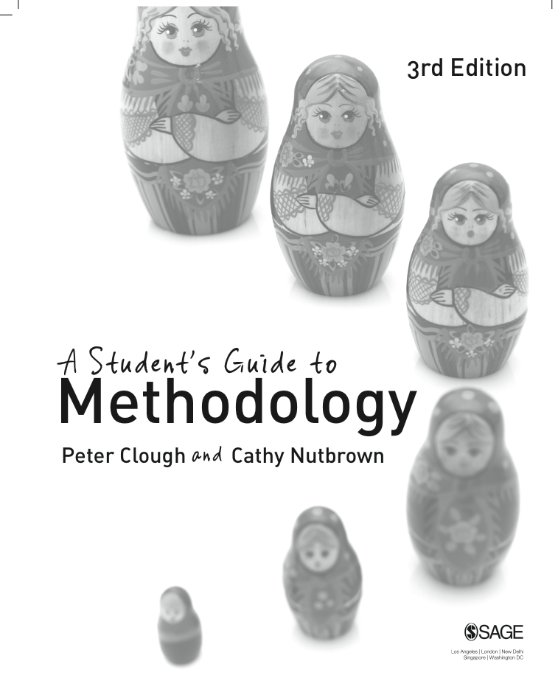
Chapter 2 What is methodology?
A methodology shows how research questions are articulated with questions asked in the field. Its effect is a claim about significance.

Slide 3
Discussion point
In small groups talk about what you understand by methodology.

Slide 4
‘The arrest of experience’
Research puts common experience into brackets, makes ‘objects’ of experience so that they can be examined and understood. One of the things which research requires people to do is to question assumptions and perceptions that are taken for granted in the normal run of everyday life; Michael Oakeshott (1933) described this as an ‘arrest of experience’, when we try to step outside our everyday experience of people, objects and places, and subject them to different sorts of examination.

Slide 5
Four forms of radical enquiry
Whatever actual methods are ultimately employed in a study, we suggest that the ‘arrest of experience’ – present in all research studies – can be characterised by four forms of radical enquiry. These are radical looking, radical listening, radical reading and radical questioning.

Slide 6
Radical looking
Radical looking is the means by which research process makes the familiar strange, and gaps in knowledge are revealed

Slide 7
Radical listening
Radical listening – as opposed to merely hearing – is the interpretative and critical means through which ‘voice’ is noticed.

Slide 8
Radical reading
Radical reading provides the justification for the critical adoption or rejection of existing knowledge and practices.

Slide 9
Criticality
‘Being critical’ describes the attempt to show on what terms ‘personal’ and ‘public’ knowledges are jointly articulated and therefore where their positional differences lie.

Slide 10
Radical questioning
Radical questioning reveals not only gaps in knowledge but also why and how particular answers might be morally and politically necessitated.

Slide 11
All researchers ask questions
Research methodology involves, at a minimum, four kinds of questioning activity: personal questions, research questions and field questions all of which give rise to ethical questions.
Personal questions.
Research questions.
Field questions.
Ethical questions.

Slide 12
Discussion point
Consider the functions of looking, listening, reading and questioning in relation to your own (proposed) research study.
Which of these tasks might currently seem to have more prominence in your own research?
Do you think that the idea of ‘feeling’ your research setting has any valid function in the context of your particular study?

Slide 13
Distinguishing between ‘methods’ and ‘methodology’
The job of method is only to ‘hold apart’ the researcher and her objects, so that we can tell the difference between them. Methods do not tell us what the thing is; they do not even describe it. All they tell us is the circumstances in which the researcher met the object; and they normally seek to provide a guarantee that researcher and object are distinct from each other. ‘Postmodern’ accounts say it is impossible to do this.

Slide 14
‘Choosing’ methods?
Channels of communication determine what may pass along them. Research methods observe this rule.
Whether using large-scale questionnaire surveys, or smaller-scale and deeper interviews, in delimiting the sorts of information which may be accessed, channels of communication – in this case, particular research methods – represent (though often tacitly) differing views on how the world is constructed and how it operates.

Slide 15
What is methodology for?
A methodology shows how research questions are articulated with questions asked in the field. Its effect is a claim about significance.

Slide 16
Research relationships
Successful – that is, the persuasive – studies are often those which demonstrate a clear, logical and reflexive relationship between research questions and field questions and in the process, deliberate, careful consideration of ethical questions. Further, this relationship is not one which is articulated only or largely in a so-called ‘methodology chapter’, but one which is also evident throughout the work.

Slide 17
Research relationships
At the heart of all these interwoven research activities are endless processes of selection; and in constantly justifying this selection, a ‘good methodology’ is more a critical design attitude to be found always at work throughout a study, rather than confined within a brief chapter called ‘Methodology’.

Slide 18
Why are research questions important?
It is important to distinguish between research questions – those that originate, shape and are to some extent answered by the study –and field questions – those that are actually put to people in whatever form.

Slide 19
Research questions require researchers to:
define the limits of their study
clarify their research study
identify empirical and ethical issues
identify necessary work on empirical questions.
plan responses to ethical issues

Slide 20
Generating and justifying research questions
Two simple tools can be employed in the generation of research questions:
the ‘Russian doll’ principle
the ‘Goldilocks test’.

Slide 21
The Russian doll principle
Applying the Russian doll principle means breaking down the research question from the original statement to something which strips away the complication of layers and obscurities until the very essence – the heart – of the question can be expressed. This may well mean phrasing and rephrasing the question so that each time its focus becomes sharpened and more defined – just as a Russian doll is taken apart to reveal finally a tiny doll at the centre.

Slide 22
The Goldilocks test
Draft research questions can be subjected to the ‘Goldilocks test’ – a metaphor for thinking through the suitability of the research questions for a particular researcher in a particular setting at a particular time. So, we can ask: is this question ‘too big’, such that it cannot be tackled in this particular study at this time – perhaps it is a study which needs significant research funding or assistance which is not usually available to students doing research for an academic award?

Slide 23
Framework for refining research questions

Slide 24
Radical questioning
Methodology is the very seat of justification of any claims which might follow. Methods mediate between research questions and the answers that data partially provide to them; methodology justifies and guarantees that process of mediation. A methodology must persuade the reader of the unavoidably triangular connection between these research questions, these methods used to operationalise them and these data so generated.

Slide 25
Ethics: pause for reflection
How do research ethics influence the design of research questions?
What are the ethical implications of radical looking , making the familiar strange, in research?
Adopting radical listening –the interpretative and critical means through which ‘voice’ is noticed – is an ethical position; what are the ethical implications for interpreting the voices of participants?
Consider how radical reading and critical reading of research are in themselves ethical practices.
How can radical questioning enhance ethical research decision making?
In what ways can your research questions help you to plan responses to ethical issues which arise in your study?

