Slide 1
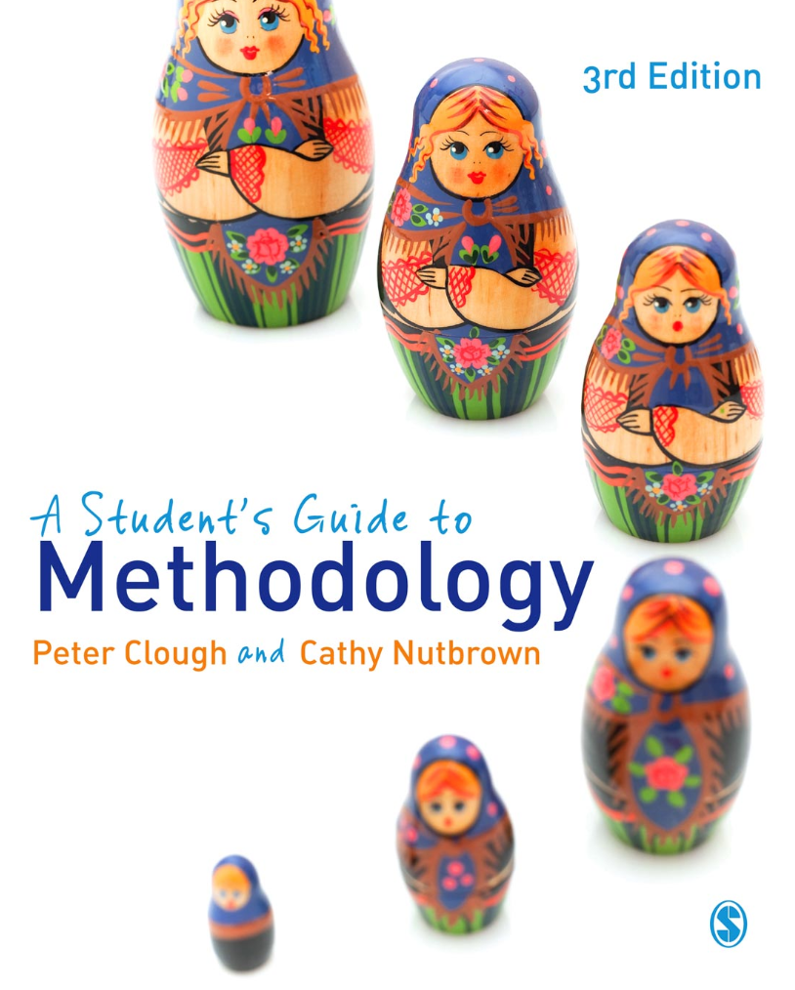
A Student’s Guide to Methodology
Justifying Enquiry
3rd edition
Peter Clough and
Cathy Nutbrown

Slide 2
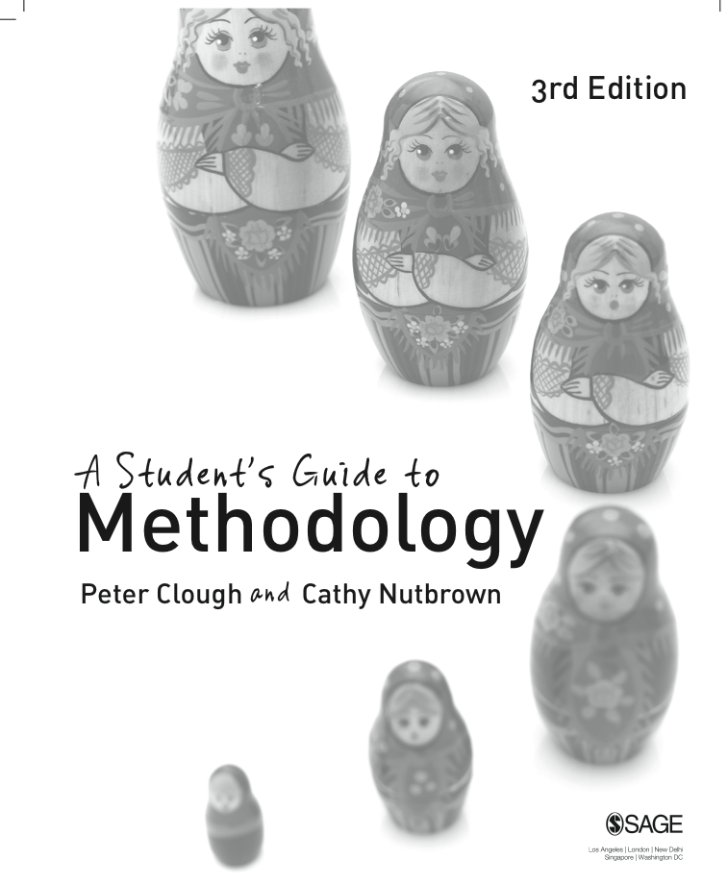
Chapter 3 Looking: seeing beyond the known
What we mean by radical looking is exploration beyond the familiar and the (personally) known, to the roots of a situation: this is exploration which makes the familiar strange.

Slide 3
Making the familiar strange
All researchers need to develop the capacity to see their topic with new and different lenses, in order to look beyond and transform their own current knowledge. Topics present themselves for research in different ways, and for all sorts of different reasons. What distinguishes research from everyday interest or curiosity, however, is the opening up of familiar things to alternative ways of seeing.

Slide 4
Observation in research
Our working definition of observation here is simply ‘looking’ – looking critically, looking openly, looking sometimes knowing what we are looking for, looking for evidence, looking to be persuaded, looking for information.

Slide 5
What are you looking for?
Radical looking holds within it the important dimension of looking for as well as looking at, the act of seeking meanings as well as evidence.

Slide 6
Ethics: pause for reflection
What are the ethical implications of radical Looking? Does the act of looking with new and different lenses in order to learn something new carry implications for the seeking of informed consent? Is it always essential to gain permission from those you are looking at?
If research is the opening up of familiar things to alternative ways of seeing, what are the implications for the researcher who sees something which is immoral, illegal, harmful or unpleasant?
When researchers look for as well as at, they are seeking meanings as well as evidence. What are the ethical implications for faithful interpretation of those meanings and that evidence?

